Slide 1
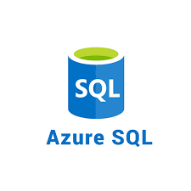




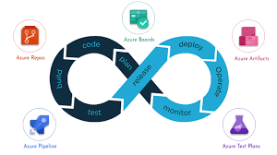
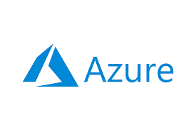
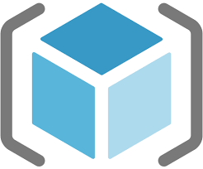
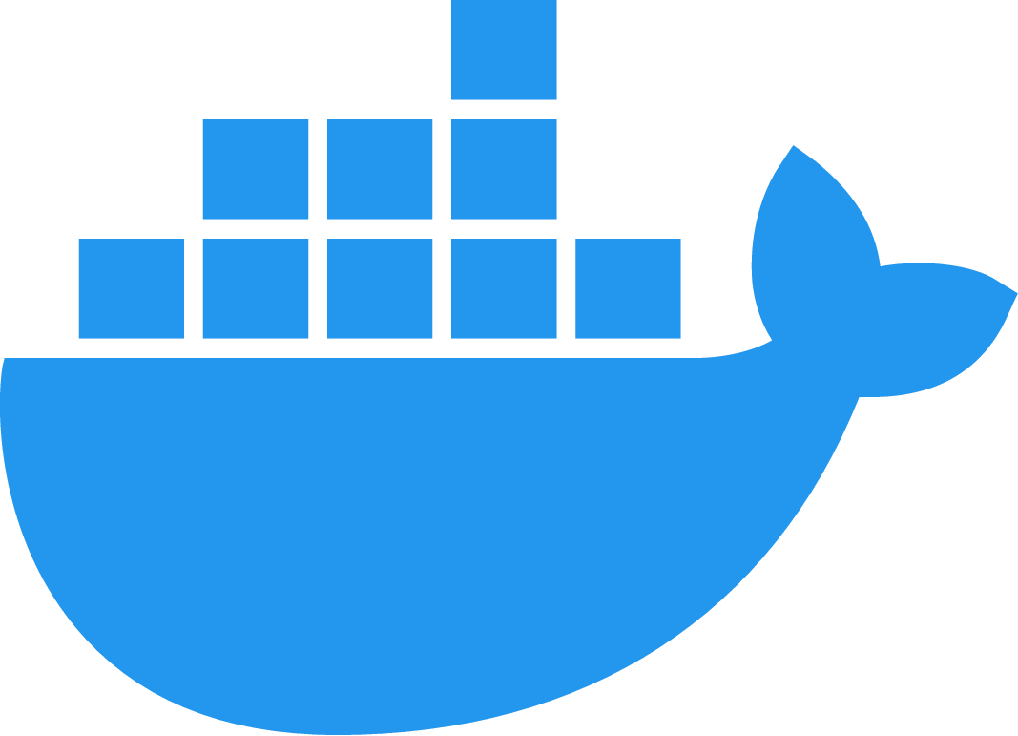

Azure Cloud and Azure DevOps Topics

Slide 2
Cloud Computing concepts
What is cloud computing and its benefits & concerns?
Different types of cloud Deployment models?
Different types of Cloud Services models?
Overview of Public Cloud provide leaders?
DevOps Concepts
What is SDLC? Waterfall model vs Agile methodology?
What is DevOps and its tool chain?
What is Continuous Integration, Continuous Delivery and Continuous Deployment?
Basic System Administration (windows & Linux)
Service/process management
User and group management
File management
Network commands

Slide 3
4. Azure Cloud Services
What is Azure Cloud and its features?
Azure Key terminology.
List of Services
Azure Virtual Machine, VM Scale Set, storage, and Network
Azure AppService, Databases, functions Apps, Azure Active Directory
Azure Kubernetes services, Azure container instances and Azure Container Registries
Practical for each services creation, configuration.
5. Containerisation and its orchestration
Docker basic commands
Docker architecture
Docker file creation
Basic architecture of Kubernetes
Manifest files development to create Kubernetes objects
Azure Kubernetes services overview.

Slide 4
6. Azure DevOps Services
Azure DevOps Services overview
Azure DevOps Organisation, Project settings and user permissions.
Azure Repos
Azure Repos Git
Basic Git concepts and commands.
External git repos integration with Azure DevOps (ex: Bitbucket, GitHub, SVN etc.)
Pull Requests submission and review
Azure Boards
Sprint planning
Epic, Feature, Product Backlog Item, tasks creation and updating
Linkup tasks with Pipelines
Azure Pipelines
Build (Continuous Integration) pipeline creation and configuration in Classic and YAML mode.
Build tool configuration for different programming languages
Release (Continuous Deployment) Pipeline creation and configuration using classic editor and YAML code
Library – Variables, Variable groups, secret file management
Environments
What are Task Groups and its benefits?
What are deployment groups and their benefits?
What are agent pools and different types of Agent pools?
Azure Test Plans
Unit Test plans
Azure Artifact
What is Artifactory?
What are different types of artifacts supported by Azure DevOps?
Create and connect to Azure Artifacts

Slide 5
7. Automation
ARM Templates to create Azure Resources
Basics of PowerShell and Bash scripting.
8. Practical:
Implement a .Net application manually and automate using Azure Pipelines (Continuous Integration) (Practical)
Creating CD Pipeline for .Net application hosting it on Webapp (Paas)(Practical)
Creating CD Pipeline for .Net application hosting it on Azure VM (Iaas)(Practical).
Creating CICD pipeline for Database Deployment (Practical).
Integrating SonarQube with Azure DevOps for static code analysis (Practical)
Creating CD Pipeline for .net application hosting it on AKS (Containers)(Practical).
Overview of Azure Security Center.
Overview of Azure Monitoring and Log Analytics

Slide 6
Thank you…!!!

